Slide 1
Chapter 7
Costs

Slide 2
Topics
The Nature of Costs.
Short-Run Costs.
Long-Run Costs.
Lower Costs in the Long Run.
Cost of Producing Multiple Goods.

Slide 3
The Nature of Costs
Economists measure all relevant costs.
  Explicit costs – direct, out-of-pocket payments for inputs to its production process within a given time period
  Implicit costs – reflect only a forgone opportunity rather than an explicit, current expenditure.
Accountants measure costs in ways that are more consistent with tax laws and other laws.

Slide 4
Opportunity Costs
Economic cost or opportunity cost - the value of the best alternative use of a resource.
The economic or opportunity cost includes both explicit and implicit costs.

Slide 5
Solved Problem 7.1
Meredith’s firm sends her to a conference for managers and has paid her registration fee. Included in the registration fee is free admission to a class on how to price derivative securities such as options. She is considering attending, but her most attractive alternative opportunity is to attend a talk by Warren Buffett about his investment strategies, which is scheduled at the same time. Although she would be willing to pay $100 to hear his talk, the cost of a ticket is only $40. Given that there are no other costs involved in attending either event, what is Meredith’s opportunity cost of attending the derivatives talk?

Slide 6
Solved Problem 7.1: Answer
To calculate her opportunity cost, determine the benefit that Meredith would forgo by attending the derivatives class.
Because she incurs no additional fee to attend the derivatives talk, Meredith’s opportunity cost is the foregone benefit of hearing the Buffett speech. Because she values hearing the Buffett speech at $100, but only has to pay $40, her net benefit from hearing that talk is $60 (= $100 – $40). Thus, her opportunity cost of attending the derivatives talk is $60.

Slide 7
Costs of Durable Inputs
Durable good – a product that is usable for years.
Two issues may arise in measuring the cost of durable goods:
  How to allocate the initial purchase cost over time.
  What to do if the value of the capital changes over time.

Slide 8
Sunk Costs
Sunk cost – a past expenditure that cannot be recovered.
Sunk cost is not relevant to a manager when deciding how much to produce now.
If an expenditure is sunk, it is not an opportunity cost.

Slide 9
Short-Run Costs
Fixed cost (F) – a production expense that does not vary with output.
Variable cost (VC) – a production expense that changes with the quantity of output produced.
Cost (total cost, C) – the sum of a firm’s variable cost and fixed cost:
C = VC + F

Slide 10
Marginal Cost
Marginal cost (MC) – the amount by which a firm’s cost changes if the firm produces one more unit of output.
  And since only variable cost changes with output:

Slide 11
Average Costs
Average fixed cost (AFC) – the fixed cost divided by the units of output produced:
  AFC = F/q.
Average variable cost (AVC) – the variable cost divided by the units of output produced:
  AVC = VC/q.
Average cost (AC) – the total cost divided by the units of output produced:
  AC = C/q
  AC = AFC + AVC.

Slide 12
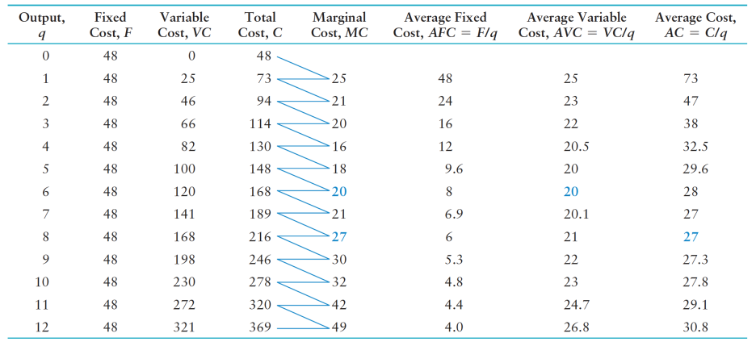
Table 7.1 Variation of Short-Run Cost with Output

Slide 13
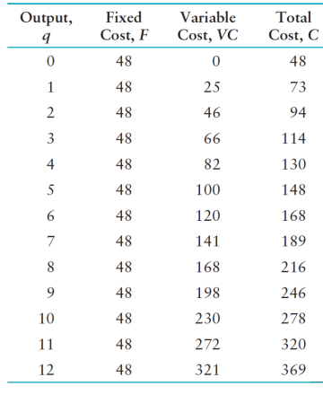
Figure 7.1 Short-Run Cost Curves
(a)
400
Cost, $
C
VC
27
216
A
1
20
B
1
120
48
F
0
2
4
6
8
10
(b)
Quantit
y
,
q
, Units per day
60
Cost per unit, $
MC
28
a
A
C
27
A
VC
20
b
8
AFC
0
2
4
6
8
10
Quantit
y
,
q
, Units per day

Slide 14
Relationship Between Average and Marginal Cost Curves
60
When MC is lower than AC, AC is decreasing…
and when MC is larger than AC, AC is increases
Cost per unit, $
MC
When MC is lower than AVC, AVC is decreasing…
and when MC is larger than AVC, AVC is increases
28
A
C
…so MC = AC, at the lowest point of the AC curve!
27
a
A
VC
20
b
…so MC = AVC, at the lowest point of the AVC curve!
8
0
2
4
6
8
10
Quantit
y
,
q
, Units per d
a
y

Slide 15
Figure 7.2 Variable Cost and Total Product of Labor
d
Total product,
13
Variable cost
Quantity, q, Units per day
c
10
b
5
1
a
0
5
20
46
77
L
, Hours of labor per day
50
200
460
770
VC
=
wL
, Variable cost, $

Slide 16
Shape of the Marginal Cost Curve
MC = ΔVC/Δq.
But in the short run,
  ΔVC = wΔL
  Therefore,
MC = wΔL/Δq
The additional output created by every additional unit of labor is:
  Δq/ ΔL = MP_{L}
  Therefore,
  MC = w/ MP_{L}

Slide 17
Shape of the Average Cost Curves
AVC = VC/q.
  But in the short-run, with only labor as an input:
AVC = VC/q = wL/q
  And since q/L = AP_{L}, then
AVC = VC/q = w/AP_{L}

Slide 18
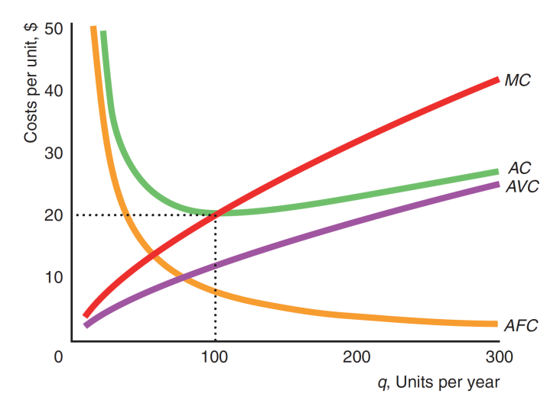
Application: Short-Run Cost Curves for a Beer Manufacturer

Slide 19
Effects of Taxes on Costs
Taxes applied to a firm shift some or all of the marginal and average cost curves.
For example, suppose that the government collects a specific tax of $10 per unit of output from the firm.

Slide 20
Figure 7.3 Effect of a Specific Tax on Cost Curves
A $10.00 tax shifts both the AC and MC by exactly $10…
a
b
M
C
=
M
C
+ 10
80
Costs per unit, $
M
C
b
$10
A
C
a
=
A
C
b
+ 10
37
$10
A
C
b
27
0
5
8
10
15
q
, Units per d
a
y

Slide 21
Solved Problem 7.2
What is the effect of a lump-sum franchise tax on the quantity at which a firm’s after tax average cost curve reaches its minimum? (Assume that the firm’s before-tax average cost curve is U-shaped.)

Slide 22
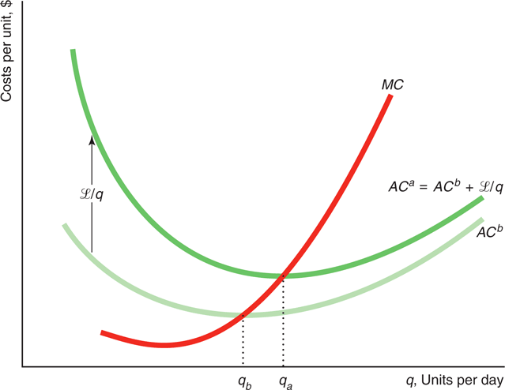
Solved Problem 7.2: Answer

Slide 23
Long-Run Costs
Fixed costs are avoidable in the long run.
  In the long-run, F = 0.
  As a result, the long-run total cost equals:
  C = VC

Slide 24
Isocost Line
C = wL + rK.
Capital
Costs
Labor
Costs
Isocost line - all the combinations of inputs that require the same (iso-) total expenditure (cost).
The firm’s total cost equation is:

Slide 25
Isocost Line (cont.)
The firm’s total cost equation is:
C = wL + rK.
  We get the Isocost equation by setting the costs at a particular level:
C = wL + rK.
  And then solving for K (variable along y-axis):
C
-
w
K =
L
r
r

Slide 26
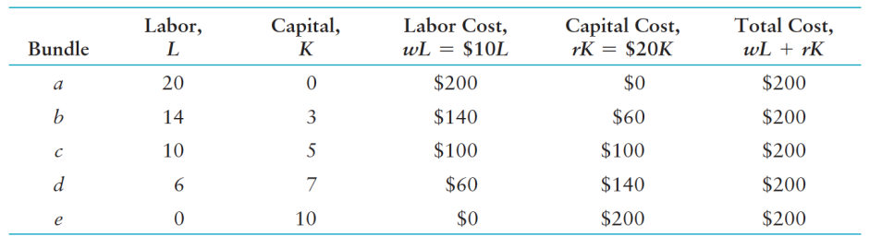
Table 7.2 Bundles of Labor and Capital That Cost the Firm $200

Slide 27
Figure 7.4 A Family of Isocost Lines
For each extra unit of capital it uses, the firm must use two fewer units of labor to hold its cost constant.
Isocost Equation
ear
y
C
-
w
K =
L
r
r
Initial Values
, Units of capital per
C = $200
w = $10
r = $20
10
=
$200
e
K
$20
7.5
d
5
c
Slope = -1/2 = w/r
ΔK = 2.5
b
2.5
ΔL = 5
$200 isocost
a
5
10
15
$200
=
20
$10
L
, Units of labor per
y
ear

Slide 28
Figure 7.4 A Family of Isocost Lines (cont.)
Isocost Equation
ear
C
w
y
K =
-
L
$200
r
r
15
=
$20
An increase in C….
, Units of capital per
C = $300
w = $10
r = $20
10
=
$200
e
K
$20
$200 isocost
$300 isocost
a
$200
=
20
$300
=
30
$10
$10
L
, Units of labor per
y
ear

Slide 29
Figure 7.4 A Family of Isocost Lines (cont.)
Isocost Equation
ear
C
w
y
K =
-
L
$200
r
r
15
=
$20
A decrease in C….
, Units of capital per
C = $100
w = $10
r = $20
10
=
$200
e
K
$20
5
=
$100
$20
$100 isocost
$200 isocost
$300 isocost
a
$100
=
10
$200
=
20
$300
=
30
$10
$10
$10
L
, Units of labor per
y
ear

Slide 30
Combining Cost and Production Information
The firm can choose any of three equivalent approaches to minimize its cost:
  Lowest-isocost rule - pick the bundle of inputs where the lowest isocost line touches the isoquant.
  Tangency rule - pick the bundle of inputs where the isoquant is tangent to the isocost line.
  Last-dollar rule - pick the bundle of inputs where the last dollar spent on one input gives as much extra output as the last dollar spent on any other input.

Slide 31
Figure 7.5 Cost Minimization
Isocost Equation
Which of these three Isocost would allow the firm to produce the 100 units of output at the lowest possible cost?
C
-
w
K =
L
r
r
, Units of capital per hour
$3,000
Isoquant Slope
isocost
MP_{L}
-
=
MRTS
K
MP_{K}
$2,000
isocost
Initial Values
q = 100
w = $24
r = $8
$1,000
isocost
0
50
L
, Units of labor per hour

Slide 32
Figure 7.5 Cost Minimization
Isocost Equation
q
= 100 isoquant
C
-
w
K =
L
r
r
, Units of capital per hour
Isoquant Slope
$3,000
isocost
MP_{L}
-
=
MRTS
K
303
y
MP_{K}
$2,000
isocost
Initial Values
q = 100
C = $2,000
w = $24
r = $8
$1,000
isocost
x
100
28
z
0
24
50
116
L
, Units of labor per hour

Slide 33
Cost Minimization
At the point of tangency, the slope of the isoquant equals the slope of the isocost. Therefore,
last-dollar rule: cost is minimized if inputs are chosen so
that the last dollar spent on labor adds as much extra output as the last dollar spent on capital.

Slide 34
Figure 7.5 Cost Minimization
Initial Values
q = 100
C = $2,000
w = $24
r = $8
MP_{L} = 0.6q/L
MP_{K} = 0.4q/K
q
= 100 isoquant
, Units of capital per hour
$3,000
1.2
isocost
MP_{L}
MP_{K}
0.4
=
=
=
=
0.05
w
r
24
8
K
303
y
$2,000
isocost
Spending one more dollar on labor at x gets the firm as much extra output as spending the same amount on capital.
$1,000
isocost
x
100
28
z
0
24
50
116
L
, Units of labor per hour

Slide 35
Figure 7.5 Cost Minimization
Initial Values
q = 100
C = $2,000
w = $24
r = $8
MP_{L} = 0.6q/L
MP_{K} = 0.4q/K
q
= 100 isoquant
if the firm shifts one dollar from capital to labor, output falls by 0.017 because there is less capital but also increases by 0.1 because there is more labor for a net gain of 0.083 more output at the same cost….
, Units of capital per hour
MP_{L}
2.5
So …the firm should shift
even more resources from capital to labor—which increases the marginal product of capital and decreases the marginal product of labor.
$3,000
=
=
0.1
isocost
w
24
y
MP_{K}
0.13
K
303
=
=
0.017
$2,000
r
8
isocost
$1,000
isocost
x
100
28
z
0
24
50
116
L
, Units of labor per hour

Slide 36
Solved Problem 7.3
Use the tangency rule to determine the cost-minimizing bundles of labor and capital for a general Cobb-Douglas production function, q = AL^{α}K^{β}, and for the specific beer production function that underlies Figure 7.5, q = 1.516L^{0.6}K^{0.4}, where w = 24 and r = 8.

Slide 37
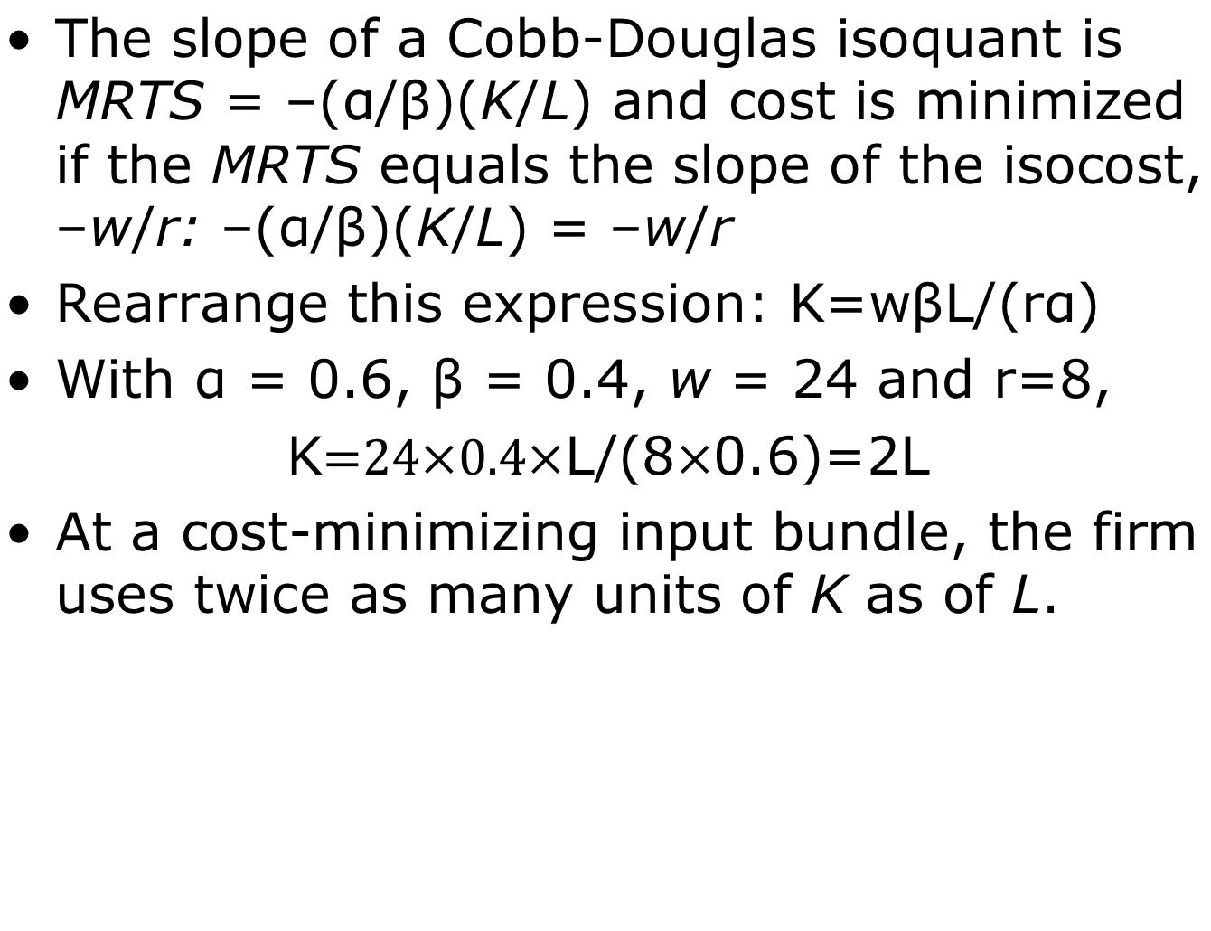
Solved Problem 7.3: Answer
The slope of a Cobb-Douglas isoquant is MRTS = –(α/β)(K/L) and cost is minimized if the MRTS equals the slope of the isocost, –w/r: –(α/β)(K/L) = –w/r
Rearrange this expression: K=wβL/(rα)
With α = 0.6, β = 0.4, w = 24 and r=8,
K$=24×0.4×$L/(8$×$0.6)=2L
At a cost-minimizing input bundle, the firm uses twice as many units of K as of L.

Slide 38
Figure 7.6 Change in Factor Price
Minimizing Cost Rule
q
= 100 isoquant
MP_{L}
MP_{K}
O
r
iginal
=
isocost,
A decrease in w….
w
r
, Units of capital per hour
$2,000
Initial Values
q = 100
C = $2,000
w = $24
r = $8
w₂ = $8
C₂ = $1,032
K
N
e
w isocost,
$1,032
100
x
52
v
0
50
77
L
,
W
o
r
k
ers per hour

Slide 39
Solved Problem 7.4
If a firm manufactures at home, it faces input prices for labor and capital of wˆ and rˆ and produces qˆ units of output using Lˆ units of labor and Kˆ units of capital. Abroad, the wage and cost of capital are half as much as at home. If the firm manufactures abroad, will it change the amount of labor and capital it uses to produce qˆ? What happens to its cost of producing qˆ?

Slide 40
Solved Problem 7.4: Answer
Determine whether the change in factor prices affects the slopes of the isoquant or the isocost lines.
Using a rule for cost minimization, determine whether the firm changes its input mix.
Calculate the original cost and the new cost and compare them.

Slide 41
The Long-Run Expansion Path and the Long-Run Cost Function
Expansion path - the cost-minimizing combination of labor and capital for each output level.

Slide 42
Figure 7.7(a) Expansion Path and Long-Run Cost Curve
$4,000
isocost
, Units of capital per hour
$3,000
isocost
K
Expansion path
$2,000
isocost
z
200
y
150
x
100
q = 200 Isoquant
q = 150 Isoquant
q = 100 Isoquant
0
50
75
100
L
,
W
o
r
k
ers per hour

Slide 43
Figure 7.7(b) Expansion Path and Long-Run Cost Curve
Long-run cost curve
C, Cost, $
4,000
Z
3,000
Y
2,000
X
0
100
150
200
q
, Units per hour

Slide 44
Solved Problem 7.5
What is the long-run cost function for a fixed-proportions production function (Chapter 6) when it takes one unit of labor and one unit of capital to produce one unit of output? Describe the long-run cost curve.
Answer:
  Multiply the inputs by their prices, and sum to determine total cost.

Slide 45
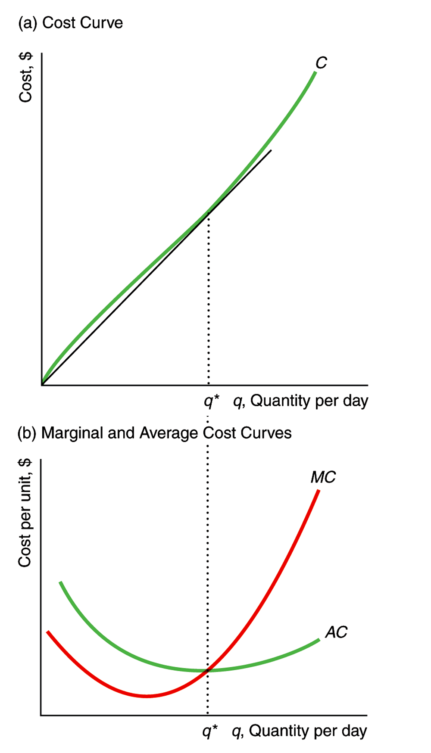
Figure 7.8 Long-Run Cost Curves
The shape of long run cost curves is determined by the production function relationship between output and inputs.

Slide 46
Economies of Scale
Economies of scale - property of a cost function whereby the average cost of production falls as output expands.
Diseconomies of scale - property of a cost function whereby the average cost of production rises when output increases.

Slide 47
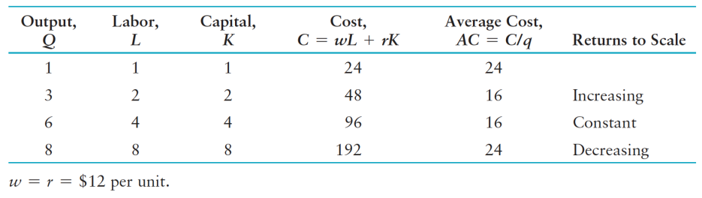
Table 7.3 Returns to Scale and Long-Run Costs

Slide 48
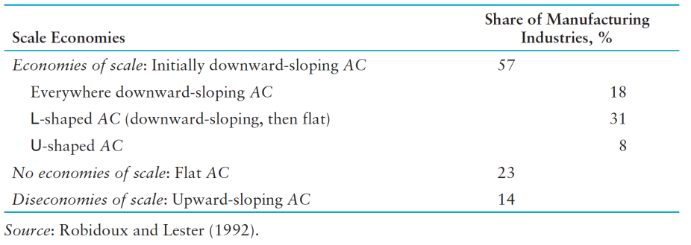
Table 7.4 Shape of Average Cost Curves in Canadian Manufacturing

Slide 49
Lower Costs in the Long Run
In its long-run planning, a firm chooses a plant size and makes other investments so as to minimize its long-run cost on the basis of how many units it produces.
  Once it chooses its plant size and equipment, these inputs are fixed in the short run.
    Thus, the firm’s long-run decision determines its short-run cost.

Slide 50
Figure 7.9 Long-Run Average Cost as the Envelope of Short-Run Average Cost Curves
age cost, $
r
LR
A
C
e
v
SR
A
C
3
A
SR
A
C
1
SR
A
C
3
SR
A
C
2
12
b
d
10
a
c
e
0
q
1
q
2
q
, Output per d
a
y

Slide 51
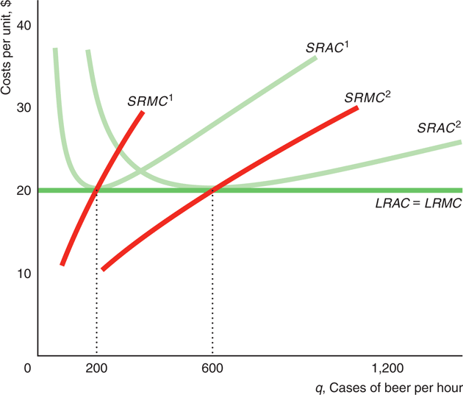
Application: Long-Run Cost Curves in Beer Manufacturing

Slide 52
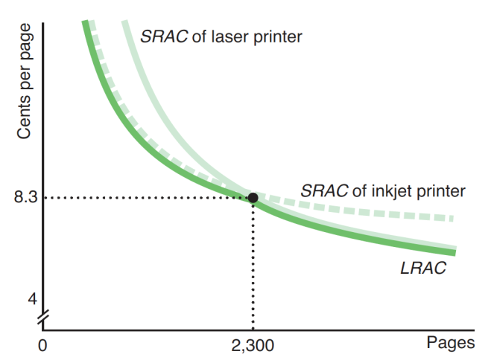
Application: Choosing an Ink-Jet or a Laser Printer

Slide 53
Figure 7.10 Long-Run and
Short-Run Expansion Paths
In the short run, the firm cannot vary its capital, so its short-run expansion path is horizontal at the fixed level of output.
In the long run, the beer manufacturer increases its output by using more of both inputs, so its long-run expansion path is upward sloping.
K, Capital per day
$4,616
$4,000
Long-run expansion path
$2,000
200
z
x
y
Short-run
100
expansion path
200 isoquant
100 isoquant
0
50
100
159
L
, Workers per day

Slide 54
The Learning Curve
Learning by doing - the productive skills and knowledge that workers and managers gain from experience.

Slide 55
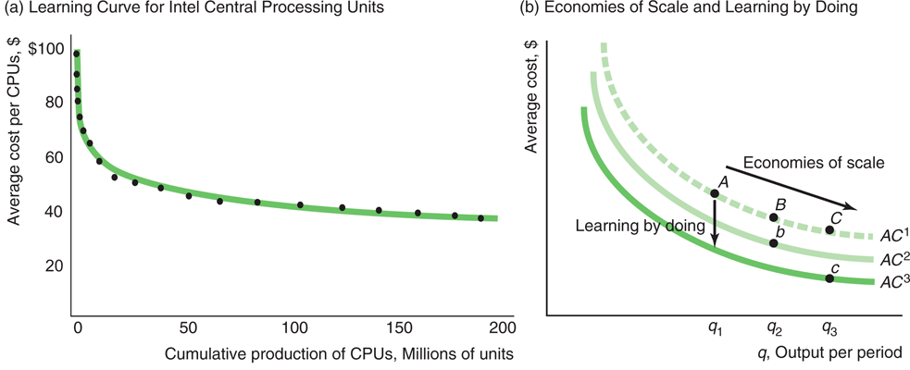
Figure 7.11 Learning by Doing

Slide 56
Why Costs Fall over Time
Technological or organizational progress may increase productivity.
Operating at a larger scale in the long run may lower average costs due to increasing returns to scale.
The firm’s workers and managers may become more proficient over time due to learning by doing.

Slide 57

Cost of Producing Multiple Goods
Economies of scope - situation in which it is less expensive to produce goods jointly than separately.
Production possibility frontier - the maximum amount of outputs that can be produced from a fixed amount of input.

Slide 58
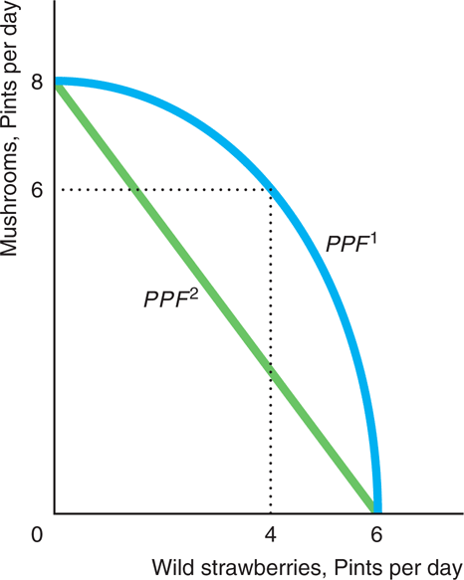
Figure 7.12 Joint Production

Slide 59
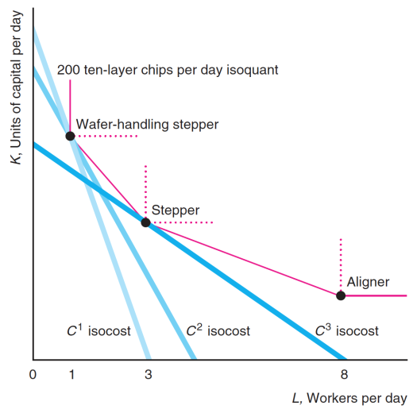
Technology Choice at Home
Versus Abroad

